Slide 1
Anti-fuzzing techniques
Zhou Zhengxiang
2022.5.6

Slide 2
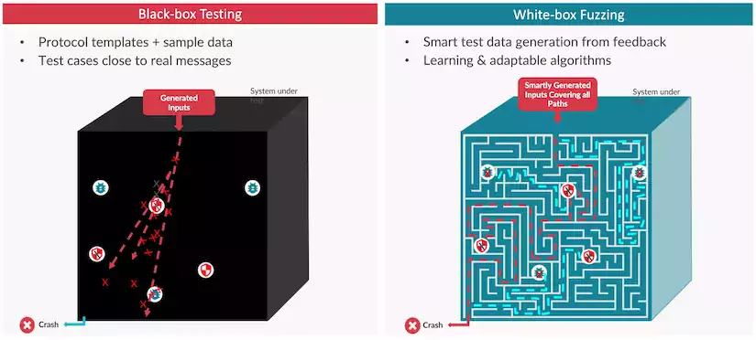
What is fuzzing?

Slide 3
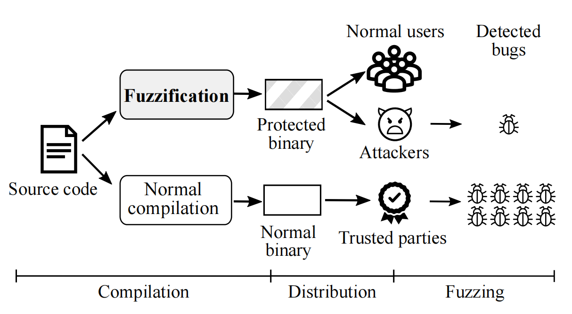
Why is anti-fuzzing necessary?

Slide 4
Existing techniques
1. Targeted detection
2. Introduce latency
3. Add fake blocks
4. Disturb data flows

Slide 5
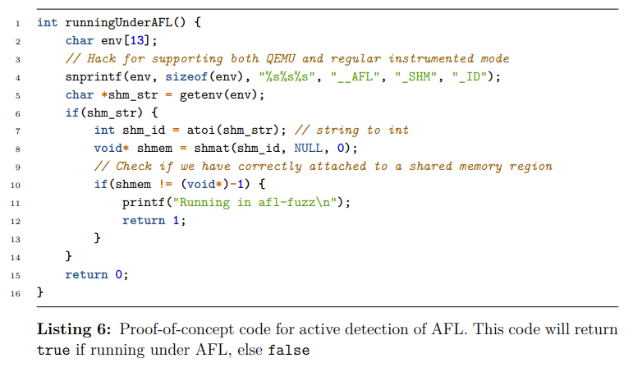
1. Targeted detection

Slide 6
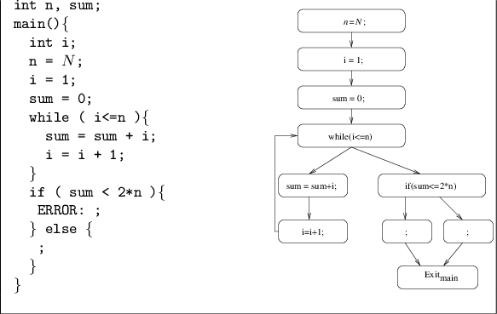
2. Introduce latency
sleep(5);

Slide 7
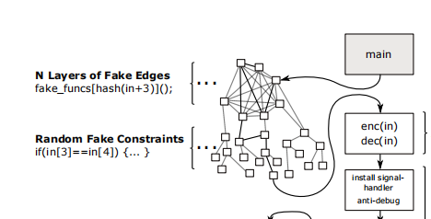
3. Add fake blocks

Slide 8
4. Disturb data flows
taint analysis
int x = input[0];
int y = input[1];
int z = x + y;
y = input[2]-input[0];
if (z - y == 0){
crash;
}
x y z
[0]
Path explosion: if (z-y == 0) => if (hash(z-y) == hash(0))
[0]
[1]
[0]
[1]
[0,1]
Implicit data flow dependencies: insert: y += x; y-=x; y+=z; y-=z; y∝x y∝z
[0]
[0,2]
[0,1]
[0]
[0,1, 2]
[0,1]

Slide 9
Motivation
Not practical -> Easier and smaller
1. Extra space cost is too large
200 bytes / function * 1000 functions ≈ 20 MB
2. Workload to determine rare executed blocks and error handling functions
3. Mannual efforts required to insert data flow dependencies

Slide 10
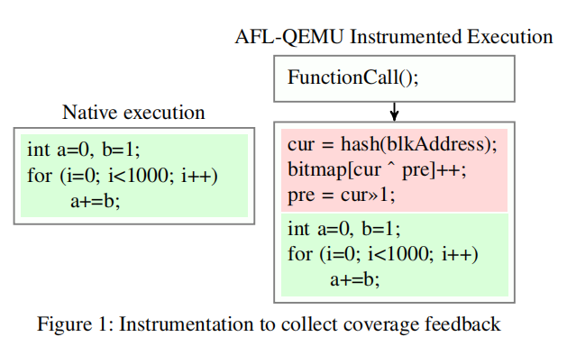
Design
1. Check instrumentations to detect fuzzers

Slide 11
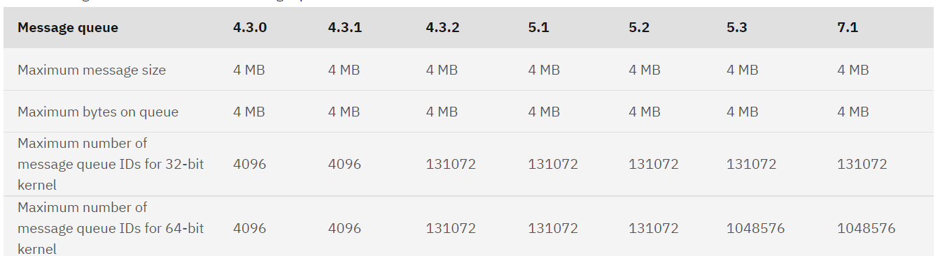
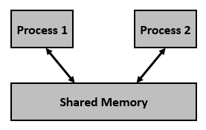
Design
2. Disable shared memory for fuzzing
int shm_id = shmget(key, 1, 0600);
Our program normal execution
Fuzzer run our program

Slide 12
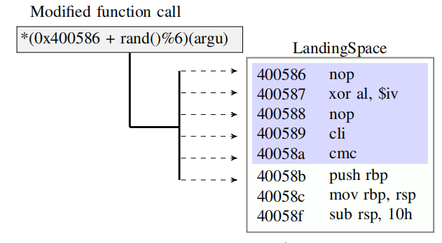
Design
3. Optimize existing techniques

Slide 13
Design
3. Optimize existing techniques
Directly hook all input functions, and disturb taint tags from the source
atfuzz_fread(input, sizeof(char), size, fp); int x = input[0]; int y = input[1]; int z = x + y; y = input[2]-input[0]; if (z - y == 0){ crash; } | size_t atfuzz_fread(void *ptr, size_t mem_b, size_t size, stream* fp){ size_t rtn = fread(ptr, mem_b, size, fp); // disturb taint tags; ... return rtn; }

Slide 14
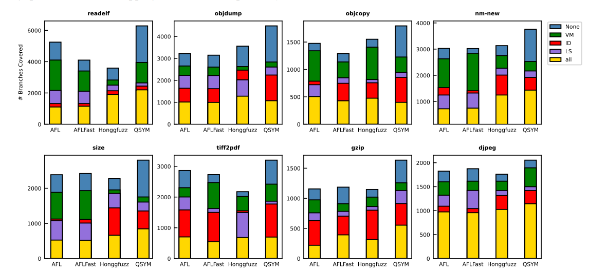
Evaluation

Slide 15
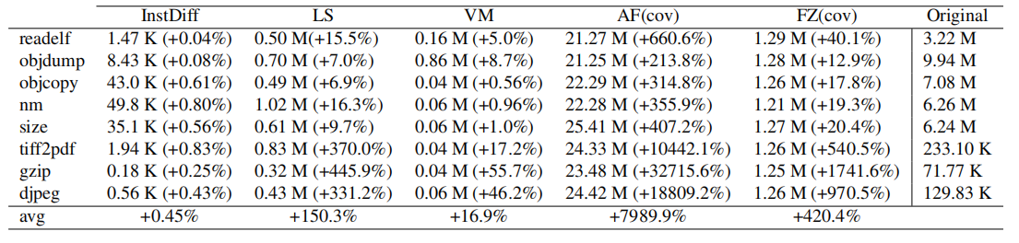
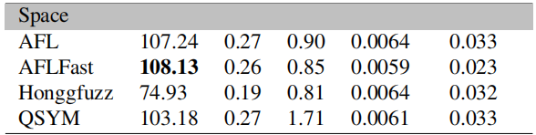
Evaluation
Average space efficiency (1 / space cost) for 1% coverage reduction

Slide 16
Discussions
Obfuscation or anti-fuzzing?
Self-modifying codes and reverse-engineering
More advanced binary instrumentation techniques
Binary rewriting technique:
Zhuo Zhang, etc. StochFuzz: Sound and Cost-effective Fuzzing of Stripped Binaries by Incremental and Stochastic Rewriting (S&P 21)

Slide 17
Reference / Q&A
[1] Jinho Jung, etc. Fuzzification: Anti-fuzzing techniques. USENIX 2019.
[2] Emre Güler, etc. Antifuzz: Impeding fuzzing audits of binary executables. USENIX 2019.
[3] Banescu, Sebastian, etc. Code Obfuscation against Symbolic Execution Attacks, 2016

